Slide 1

WEATHER APP USING FLASK

Slide 2

PROJECT GOALS:
Provide real-time weather information to users
Allow users to search for weather data for specific locations
Display weather forecasts, current conditions, and additional details

Slide 3

Technologies Used:
Flask: Web framework for building the app
Open Weather Map API: Retrieves weather data
HTML and CSS: Front-end design and styling
Python: Backend logic and data processing

Slide 4
App Structure:
Main components of the app:
Flask routes and views
Templates for rendering HTML
Static files for CSS and images

Slide 5
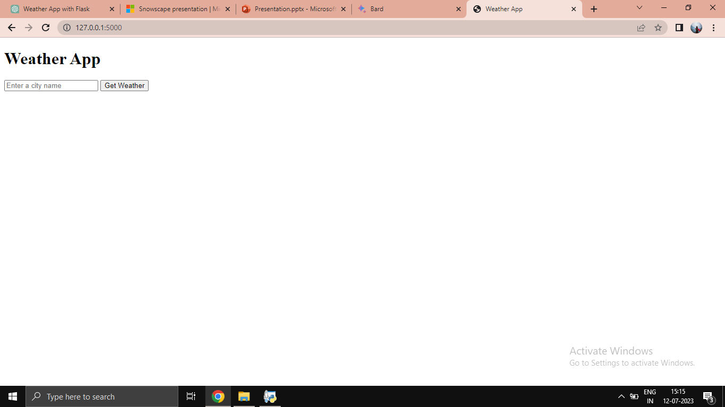
OUTPUT:

Slide 6
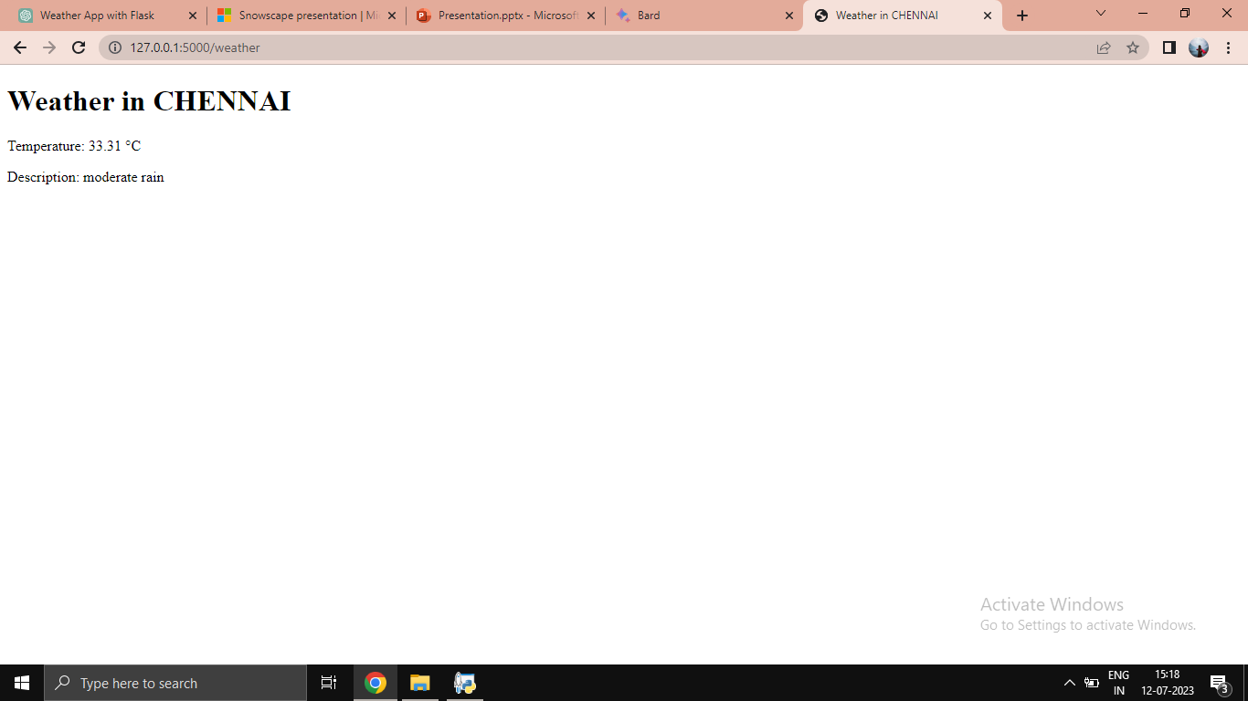

Slide 7

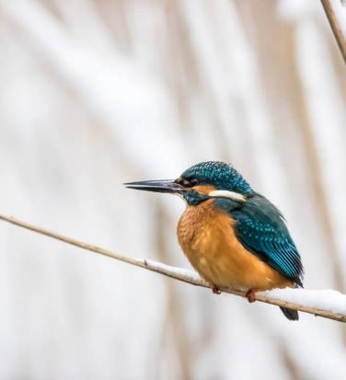
CONCLUSION
This presentation has shown how to create a simple weather app using Flask
The code for the app is available on GitHub
You can use this app as a starting point to create your own weather app

Slide 8

PRESENTED BY:
Aarthi Mahalakshmi V
Charu Bala
Deepika D
Divya Vaishnavi V
Fariya Rahmath
Gayathri Devy
Gayathri R

